Slide 1
Catch Fire and Halt
Fire in the Datacenter
Jon Kuroda - UC Berkeley EECS Research
jkuroda@eecs.berkeley.edu

Slide 2
Follow the Bouncing Slide
Slides available to follow along at
http://tinyurl.com/MicronetFeb2017

Slide 3
Thanks and Acknowledgments
I would like to thank the following for … Everything
UC Office of General Counsel and Outside Counsel
Manufacturer, Insurance & Forensics Investigators,
Campus Risk Services, Campus Fire Marshal,
System Integrators, Environmental Health & Safety,
CIO’s Office, Datacenter Staff, EECS Department Chairs,
Lab Director, Faculty, Management,
And the Academy … All of you

Slide 4
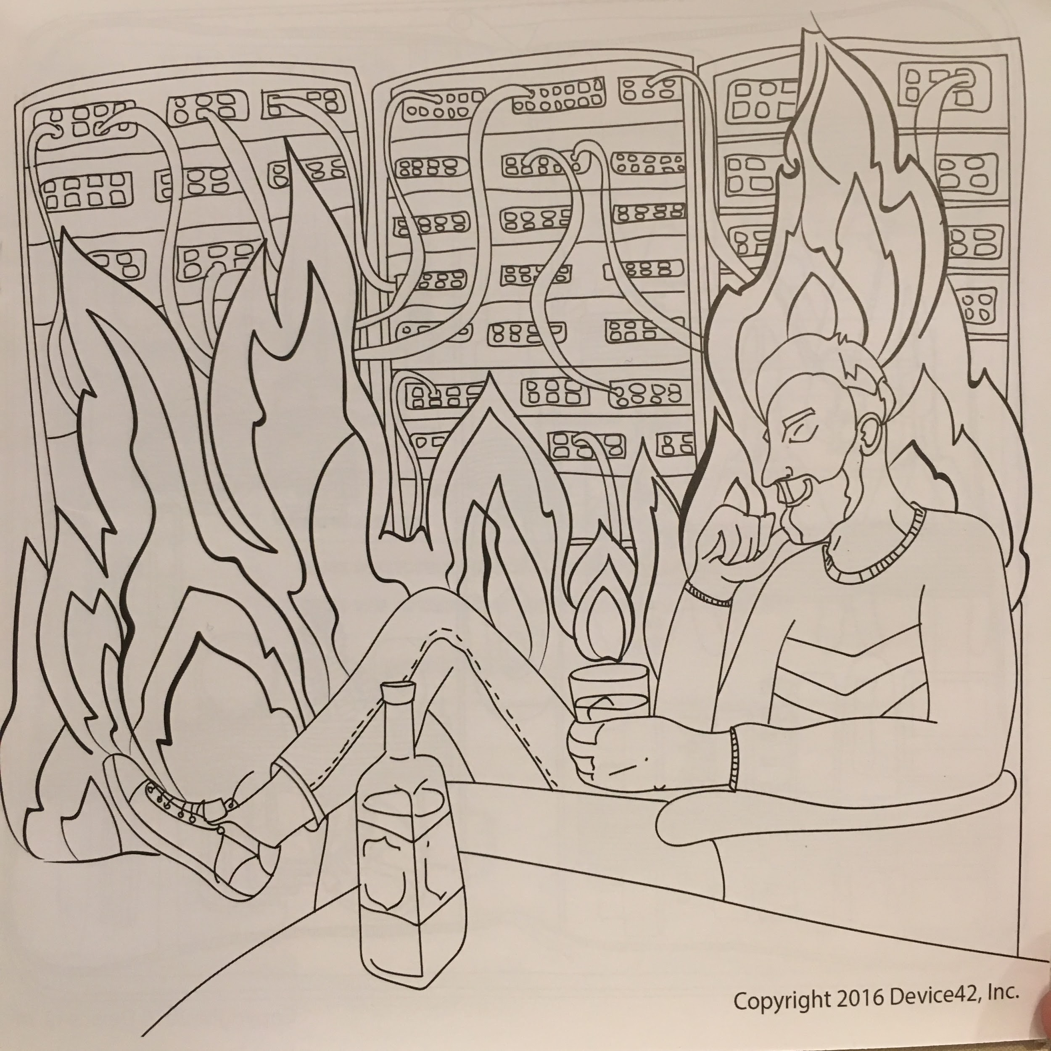
Some levity
From the USENIX LISA 2017 Coloring Book
Much Relevant.
Such On-Point.
Wow.
The Timely.

Slide 5
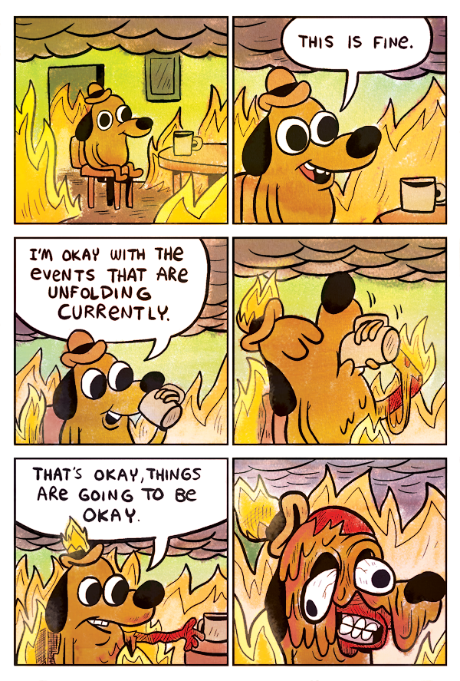
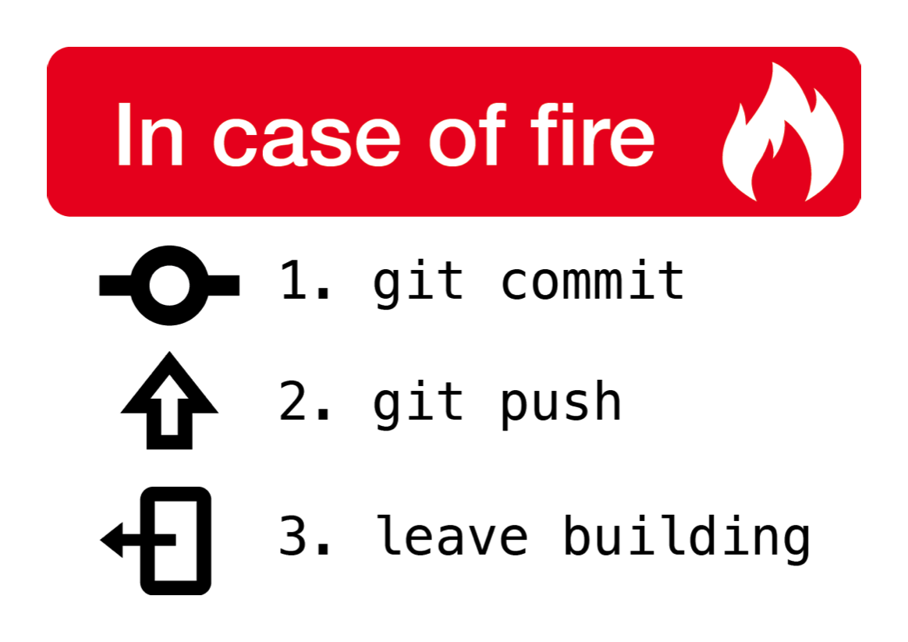
Remember, in the event of fire …

Slide 6
What Happened - TL;DR version
Co-located Customer System Caught Fire in Campus DC
6:48PM, 18 Sep 2015, UC Berkeley Campus Datacenter
Fire Suppression and Emergency Power-Off (EPO) systems activated
Almost all Campus online systems and co-located customer systems offline
Recovery lasted through the weekend
Forensics and Insurance Investigations through mid-2016
Ensuing settlement talks through Fall 2016
No injuries, deaths, or anything worse than lost sleep, stress, or paperwork.
Notes:
“TL;DR” Too Long, Didn’t Read

Slide 7
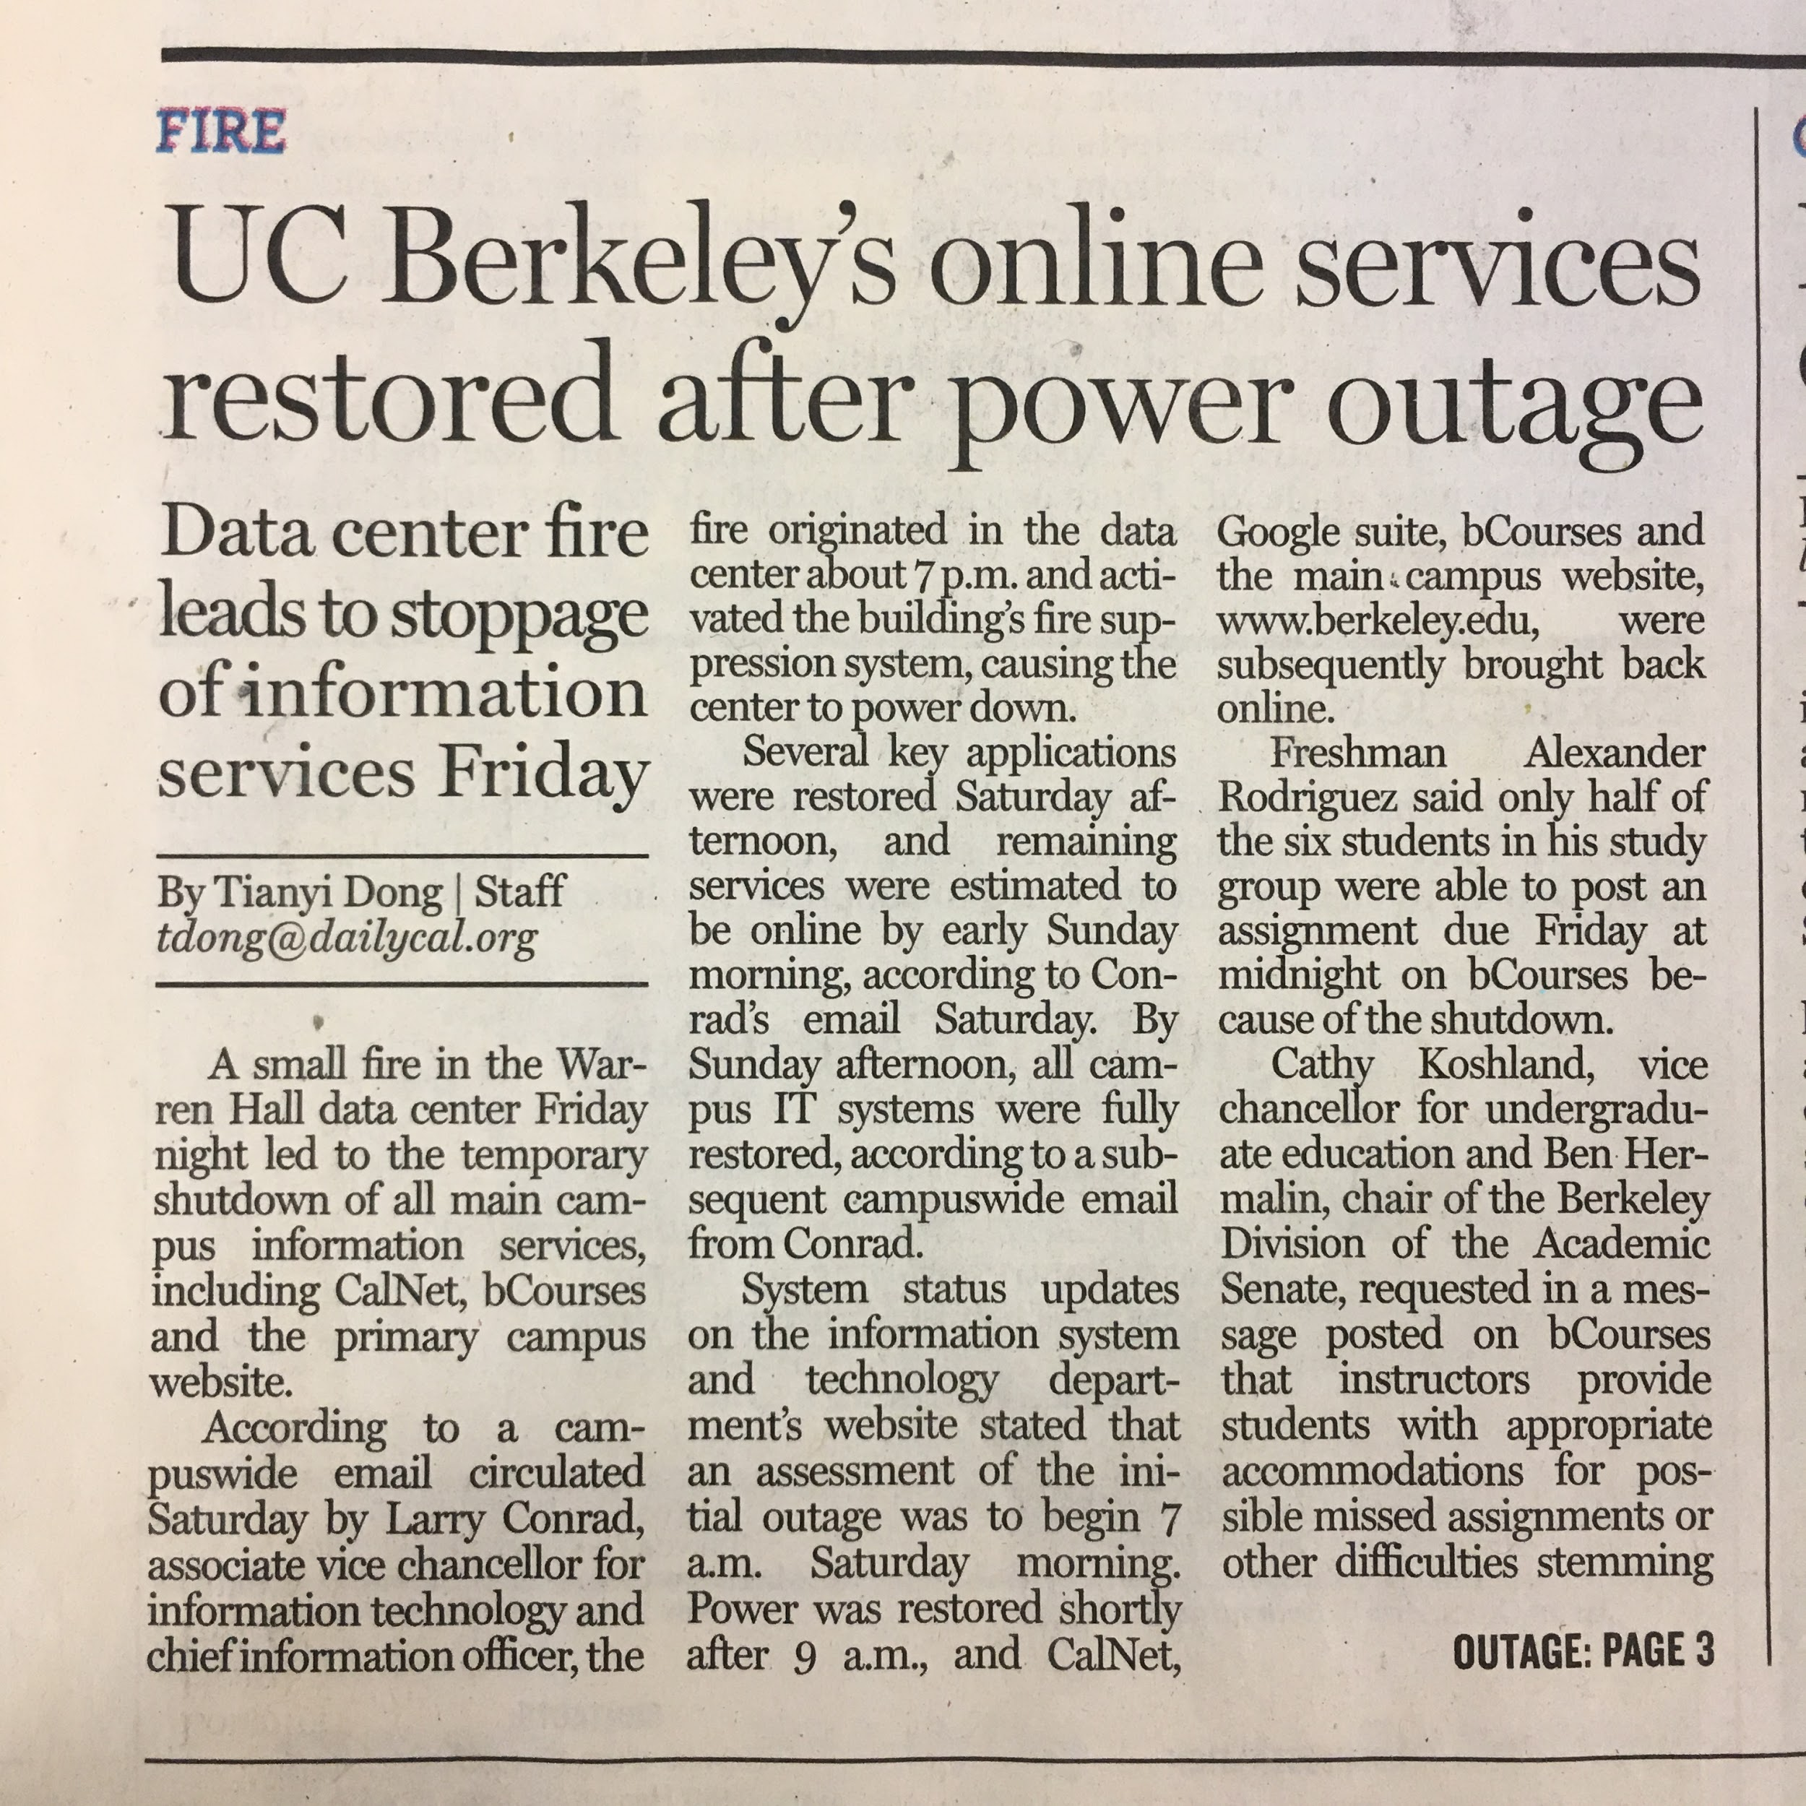
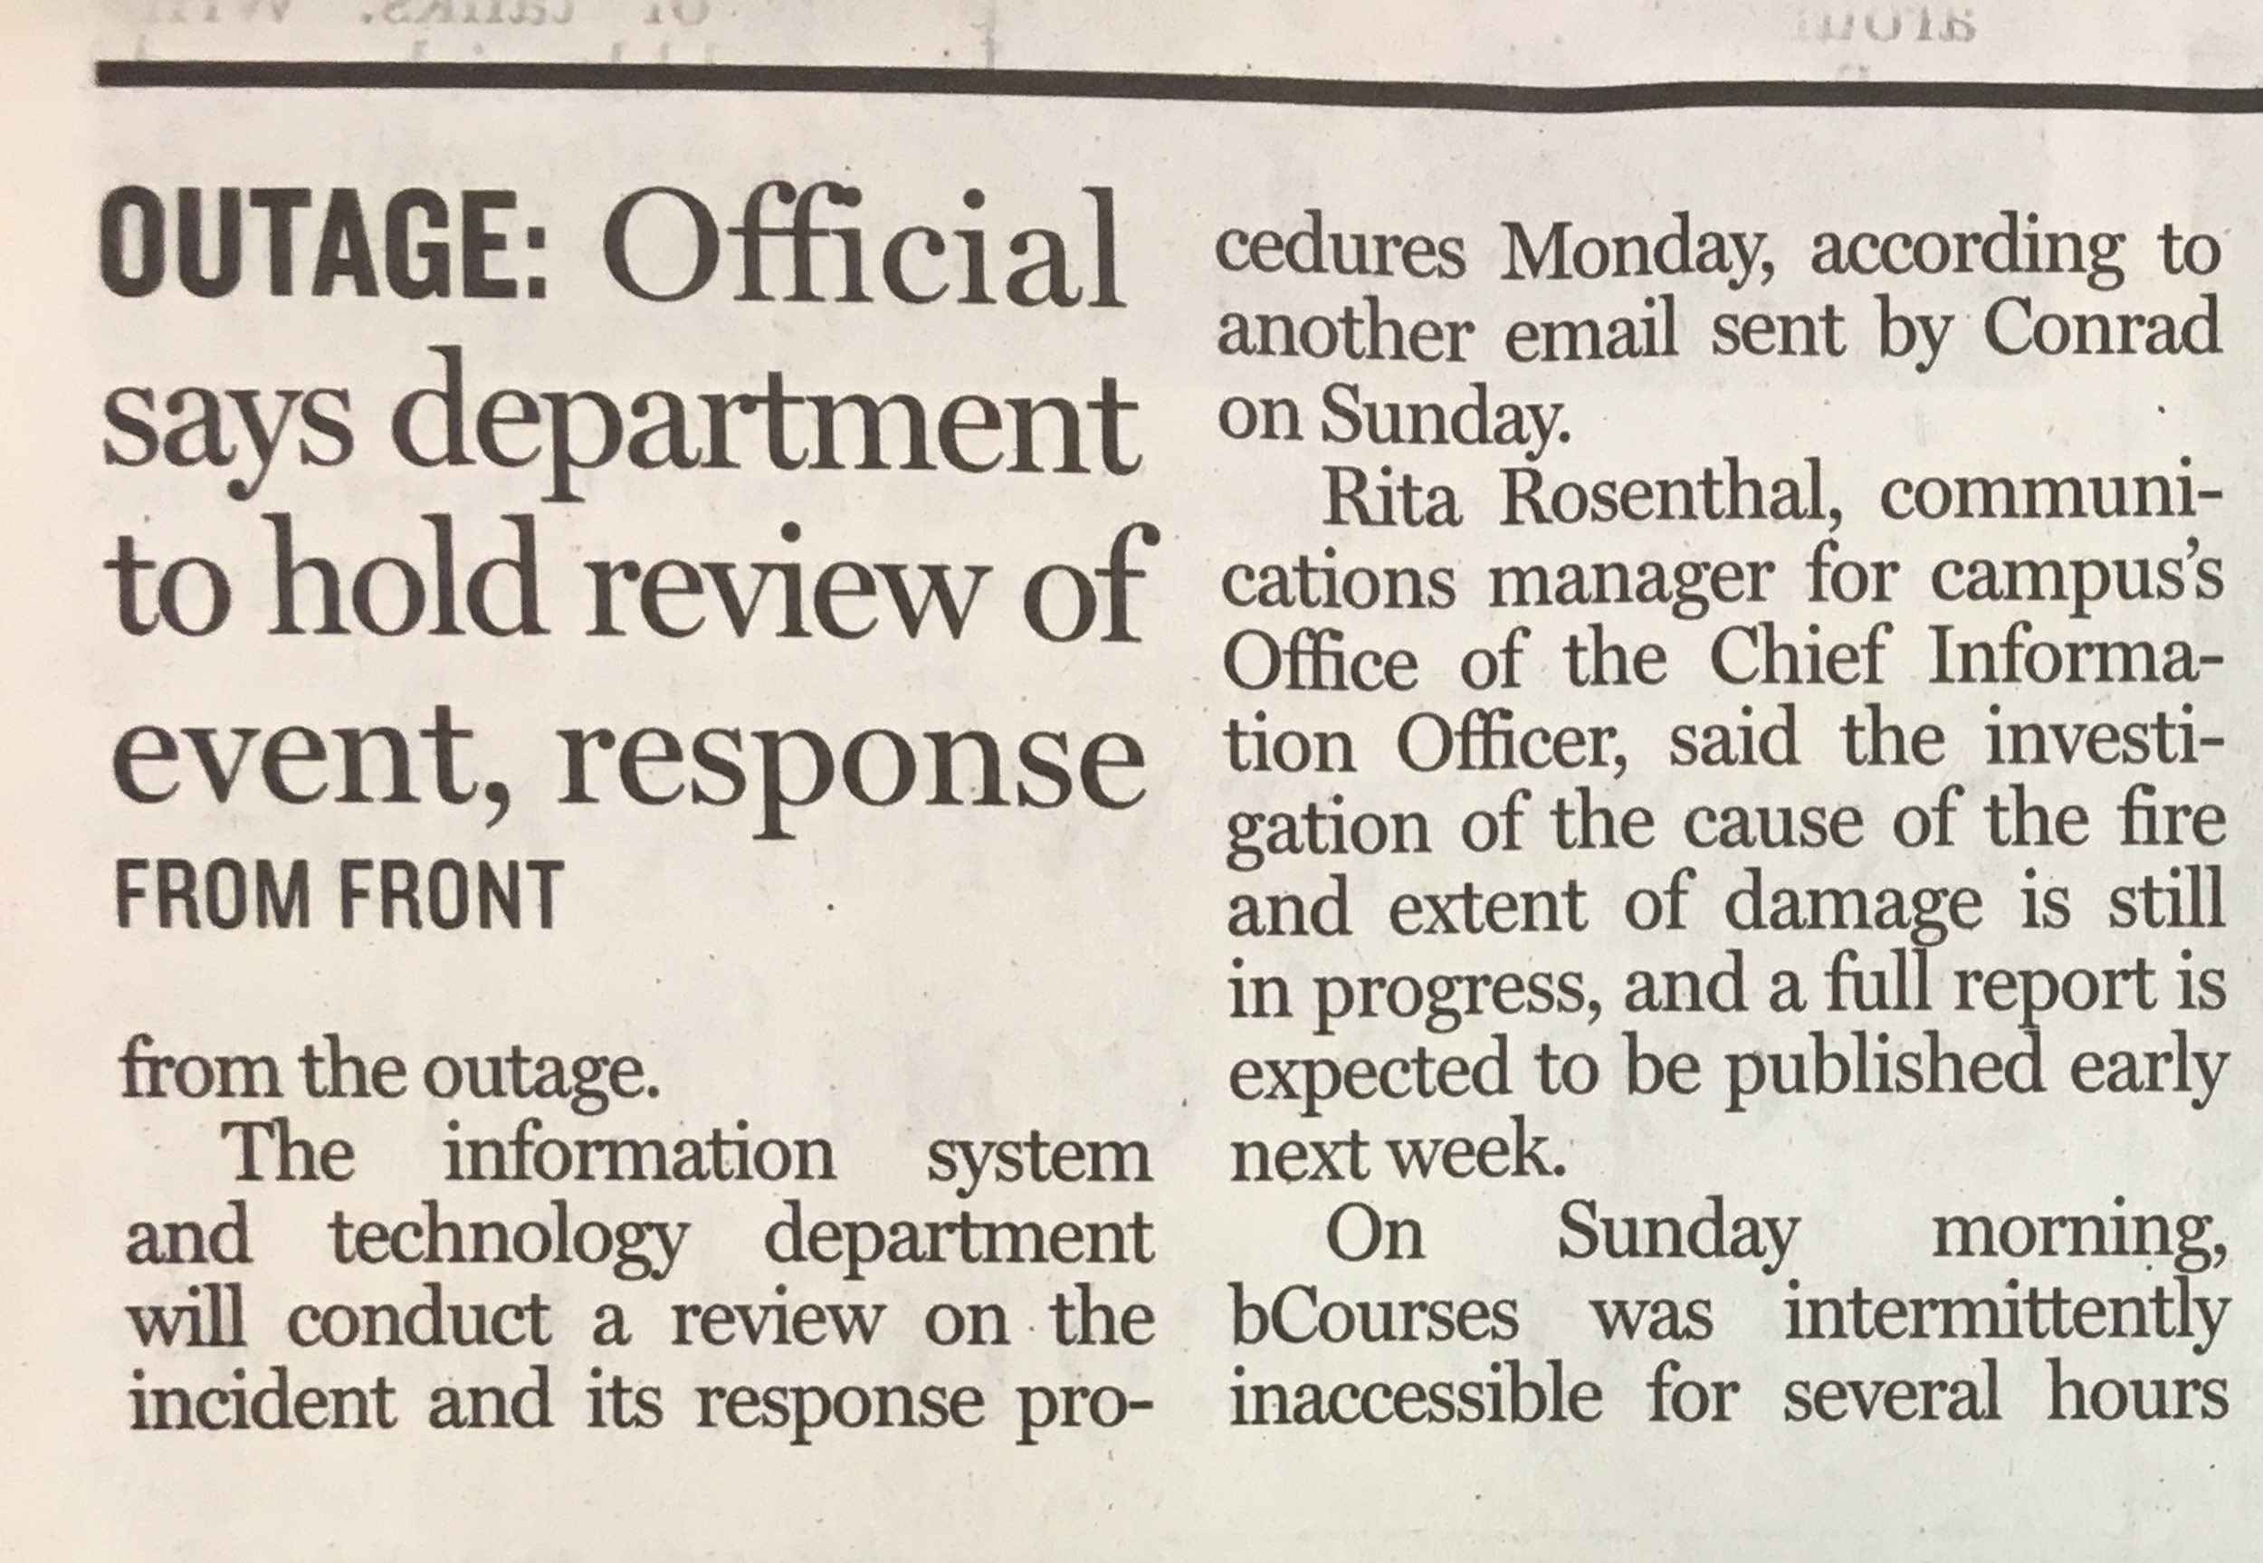
Press and Other Coverage
NFPA 75 Whitepaper on Fire Protection and Suppression in Datacenters
Notes:
From our Student Newspaper, the Daily Cal. We even got mention (a few months later) in a UL whitepaper: http://library.ul.com/?document=nfpa-75-and-fire-protection-and-suppression-in-data-centers

Slide 8
Caveats Before I Continue.
Settlement negotiations impose some restrictions.Therefore:
No identification of any non-UC Berkeley parties involved
No identifying photos of any involved equipment
No discussion of the specifics of the system itself
No discussion of the findings of the investigation
No, really.
These decisions take place far above my “pay grade.”
Notes:
I can tell you things like “Our systems use Intel x86 CPUs, or Samsung or Intel SSDs, or Samsung or Micron RAM, or Hitachi or Seagate HDDs” but not things like “Who manufactures our systems,” or “Who we bought them from.” I mean, people like me don’t even get to know the details of the settlement aside from the confidentiality clauses.

Slide 9
Okay, it sucks, but how common is this?
Somewhat rare - but, fires and other outages do happen
Electrical Infrastructure caught fire (Iowa State Gov’t)
Another Datacenter Fire (Samsung SDS, S. Korea)
Outage via Auto … Intrusion (Rackspace, Dallas, TX)
Electrical Infrastructure Fire ($10M!!) (Seattle, WA)
Contractors … Amazon (Ashburn, VA)
Multiple Lightning Strikes (Google, Belgium)
… These things and more happen. Are you ready?

Slide 10
A System Caught Fire? Wat?
One of my research group’s systems caught fire
First public acknowledgement at USENIX LISA16
But it’s been a semi-open secret on campus a while.
Those in the know have (mostly) been very good re: this.
That said, it’s been a sensitive topic the past year or so
Everybody learned something from this event.
Notes:
Mostly. A semi-informed staff member in Campus IT posted mostly incorrect information on a public mailing list 3 months after the event. We couldn’t comment due to ongoing investigations and settlement negotiations.

Slide 11
Extensive post-event communication with ...
Manufacturer, System Integrators
Campus Fire Marshal, Campus Risk Services,
Environmental Health and Safety,
Insurance and Forensics Investigators,
UC Legal Counsel, Outside Counsel
Many separate Post-mortem/retrospectives/investigations
So. Much. E-Mail.
Notes:
Those with whom I’ve had the most communication - bold

Slide 12
The System that caught fire
COTS 2U x86 server, reputable vendors, delivered Q4 2012
Intel Sandy Bridge-EP CPUs, Samsung DDR3 RAM, Intel/Samsung SSDs, Seagate HDDs
100% Commodity Components from Reputable Vendors
Moved from EECS Dept to Campus Datacenter Q3 2014 along with 9 others
Recently reconfigured (that afternoon) to a low-memory config for a researcher request
To be returned later to a high memory config for use in a Spark / HDFS cluster
1 of 3 (now 4) racks used by our group - 2 devoted to separate uninvolved Genomics Cluster
Part of a larger order of 30 systems
~90% of our local compute capability.
Notes:
COTS: common/commodity-off-the-shelf aka Commodity.
The irony of the name “Spark” is not lost upon us.

Slide 13
How Does a Modern Server System Catch Fire?
Obviously, something went wrong.
We still cannot discuss details at this time.
Notes:
This should be in RED for “Redacted” but it was starting to give me a headache.

Slide 14
Timeline for Friday, 18 Sept 2015
~6:20PM: Last customer (Me) signs out of facility, (tries to) get dinner.
[~6:45PM: System catches fire in Datacenter]
[6:47PM: Smoke Sensors triggered]
[6:48PM: FM-200 Clean Agent Fire Suppression / EPO systems activate]
Nearly 4000 pounds / 1300kg of FM-200 Fire Suppression Agent
~8:30PM: Customer returns to campus office after dinner
Notices many Campus services offline, starting around 6:48PM
First thought: “Great, another weird EECS/Campus routing flap.”
~9:00PM: Customer sees 8PM report of “Halon System” use at campus DC
9:05PM: Customer sends quick FYI to his management.
Okay, maybe not a “Weird Routing Flap”
Maybe still a false alarm that triggered the fire suppression system.
Notes:
We’ll look at some excerpts from Detailed Timeline
Roughly 2-hour attempt to get dinner in Downtown Berkeley on a Friday night. Without Reservations.
[events] are those I was unaware of until “next slide”
There is some ex post facto significance to the timing of my exit that we’ll talk about.

Slide 15
Timeline for 18 Sept 2015: Ooooooh. Bad.
9:30PM (approx): Customer sees new post on Campus System Status site:
Fire in campus data center. Tons of stuff down. - IST Service Status
Friday 09/18/2015 21:18: There was a fire in the data center. Extent is not known at this time. Steve Aguirre [DC Manager] is on-site and actively working on the issue(s). ETA unknown at this time.
The CSS-IT Service Desk is receiving reports that internet connectivity has been interrupted for multiple applications, users, and locations across campus.
IST is working to identify the root cause and resolve the issue.
No ETA is available at this time.
Timing of my departure relative to fire ⇒ sobering observations.
Notes:
Thank you Google for conveniently saving an early title for this particular event status page.

Slide 16
How bad was it?
Notes:
Pretty bad.

Slide 17
What was down?
“Everything.” Not really, but it sure felt like it.
No “CalNet”
No WiFi. No bCourses, No BFS, No BearBuy, No Blu, No BAIRS, No Nothing
No IST Storage, no IST VMs, No Oracle. “Ton of Stuff Down”
Many of those services not even up to complain about lack of authentication
Even access to Google Services affected (no SSO)
Campus website down. Whoa.
EECS Departmental Maillists, Jabber/XMPP instance
Hosted at or dependent upon services hosted in the Campus Datacenter
Heavily impacted ability to notify people within the Department
Notes:
Even the open-access “CalVisitor” Guest Network didn’t work due to unavailability of a blacklist of MAC addresses.
There was a non-production authentication gateway elsewhere on Campus that had been put up for demo purposes, but few remembered it was still up and fewer services were pointing at it anymore. We have off-site replicas of the authentication gateways, but those were only activated via DNS updates in the event of a larger-scale/longer-term campus emergency. This event may change that.

Slide 18
What still worked?
A few basic services: didn’t seem like a lot, but it was.
Campus Network and most basic Network Services
IPV4/IPV6, DNS, NTP, attwifi, but no DHCP on Campus-managed networks
SMTP Delivery for @berkeley.edu and other hosted berkeley.edu domains
Offsite MX systems at SDSC for the win
IMAP clients could still authenticate, active web client sessions too.
Campus System Status site - hosted off campus at 3rd party provider
Campus Emergency Website (if needed) - hosted off campus at NYU.
Campus Emergency Notifications - “WarnMe” - use of 3rd party service
Most Depts’ “In-House” services w/o dependencies continued to work
Notes:
Could post to Reddit/Twitter/Facebook, but not submit homework. Students Rejoice?
ResHall wired networks worked. EECS Wired/WiFi worked.

Slide 19
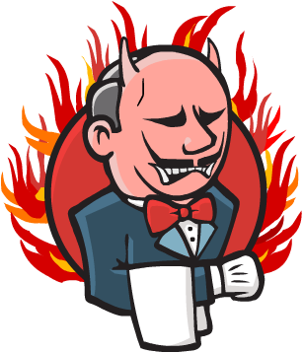
What Else Went Down?
Our Research Group’s Jenkins Instance
CI for 2 large Open Source Projects we spun out and our smaller projects.
Apache Spark™ and Alluxio (Formerly known as Tachyon)
Hosted at the Campus Datacenter, exposed through our in-house hosted website
Fortunately, it was a Friday night, so few people noticed, but this is probably my research group’s most notable externally facing service.
Some attempts made to notify key developers in those projects, but Friday night.
Notes:
That is the image Jenkins pops up when … “Displeased”.

Slide 20
Detailed timeline: Back to Our Story
~10PM: Customer returns to Campus DC to assist with recovery efforts
Saw one developer on the way - “Don’t Commit” “No worries! Good Luck!”
Electricians, Other Customers, Exec Dir of Environmental Health and Safety (EHS) waiting
Local FD not allowing any non-essential staff into the building yet.
Customer’s Manager drives-by to offer moral support (He had been enjoying Friday night.)
~10:30PM: Non-essential staff allowed in by FD and Campus Fire Marshal
DC staff on duty at time of fire exits to go home having been relieved by fresh staff.
“Kuroda! You were the last one out! What did you do!?” Haha. LOL. If only we knew then ...
First thing we noticed upon entering the ground floor ...
Notes:
Was already past the Ballmer Peak

Slide 21
Whoa, It’s Warm.
Datacenter itself on the 3rd floor, but even the ground floor was warm.
~90F/30C when we arrived. Reportedly around 120F when FD arrived.
10,000 ft² of DC space ⇒ lots of systems ⇒ lots of residual heat
EPO ⇒ No Power ⇒ No HVAC + lots of residual heat ⇒ Warm++
HVAC needs to shutdown to allow FM-200 system to work
(Reportedly not all racks powered off … Local FD used Manual EPO)
This could have had major repercussions.
Notes:
It was around 90F when we entered. Reportedly, when FD arrived, it was around 120F, and not everything had turned off. Can go to backup slide for explanations of repercussions

Slide 22
Wait. What do you mean “Repercussions”?
FM-200 system was depleted
Sprinkler system only backup to prevent Loss of Building
If temperature rose enough at the sensors, it rains inside.
Sprinklers are zoned to limit impact to affected area ...
Sprinklers activate at 165F - ceiling temp of 180F-200F
This would protect the building, but at the risk of servers/etc.
But wait! Wait! There’s more!

Slide 23
But wait! Wait! There’s more!
UPS room on the roof with the generator
Remained online despite DC EPO - separate “fire zone”
HVAC controller system shutdown due to EPO - no HVAC
Even if low system loads, UPS batteries charging ⇒ Heat
Sprinklers activate at 165F - ceiling temp of 180F-200F
This Is Bad. Mmmm’kay?

Slide 24
Back to our Story: One problem to solve first
Find the ignition source of whatever triggered the smoke sensors
Local FD and Fire Marshal cleared the scene for less essential staff
Fire Marshal wouldn’t OK power-on before ID of ignition source
Two smoke sensors localized it to a zone of racks
Turned out to be hard due to FM-200/smoke sensor interaction
Fire Marshal had detected fading odor of burnt electronics
We had power for lights, but camera/video system offline.
It was 11PM and we needed to find what tripped the smoke sensors.
Notes:
Fire Marshal had to pore over the Fire Alarm Control Unit carefully to find the smoke sensors that triggered first - the FM-200 discharge itself set off the rest of the smoke sensors, so all of them were lit up in the panel, not just the 2 that activated the fire suppression and EPO.
FM-200 system so effective, Local FD and our Fire marshal couldn’t find any residual smoke or flames anywhere - they thought that it could have been a false alarm despite two separate smoke detectors going off.

Slide 25
Row by Row, Rack by Rack
We had people. It was only ~90F/30C. “Rack To Rack” it was.
Started with the rows of racks covered by the tripped smoke sensors
“Let’s just get my racks out of the way and cross those off the list …”
I, as one of few customers there, opened up my racks in that zone
Yeah … Maybe not so much. Hi, Stomach of mine, meet the floor.
“I think I know what caught fire.”
That got everyone’s attention …
I considered my career options ...
Notes:
Thoughts included “Will I still have a job?” “I should have looked harder at jobs in Chicago” and “I always wanted to build custom bespoke furniture”

Slide 26
OK, fine, some purposefully obfuscated pictures.
Well, maybe not

Slide 27
Yeah, something bad definitely happened.
Nope, still not yet

Slide 28
First Look “Under The Hood”
Wish we could ...

Slide 29
Another look “under the hood”
Maybe later ...

Slide 30
Saving the worst for last ...
But not now.

Slide 31
So, um, wow … like whoa.
Till I saw this, I did not once think one of my boxes had caught fire.
DETAILS OF SYSTEM DAMAGE REDACTED
Complete and Total Loss of Server System.
Contact Heat Damage to adjacent Server System.

Slide 32
Can’t talk about this
Notes:
These next three slides described details of the initial investigation conducted by on-site staff that evening.

Slide 33
Or this

Slide 34
… or that ...

Slide 35
The Flow of Information to Campus Leadership
“Which department did you say you were from?” I was asked.
“EECS,” I replied
“Thanks *taptaptap* *send*”
“Who is that going to?” as I saw the e-mail go out from his phone.
“Lyle. [Campus Deputy CIO]”
“Ah, okay.”
I mean, as long as it wasn’t the Daily Cal or something.

Slide 36
What now?
I was now the man on the scene.
I hadn’t intended it when I came down to lend a hand … but there I was.
No running away - here’s my info, my management’s, my faculty’s …
Upsides:
Ignition source Found. Scope and extent of fire defined by midnight
Recovery operations could begin - starting with HVAC and Power.
But these things are never easy.

Slide 37
Which came 1st, Chicken Power or Egg HVAC?
How often do you do cold-start fire drills of your facilities?
HVAC control systems needed power.
Can’t turn on power until the HVAC is running …
But that UPS room is still running ...
No restoration of power until early AM.

Slide 38
While waiting on status update about power ...
[REDACTED]
[REDACTED]
[REDACTED]
[REDACTED]
Customer notified his own management
Customer unplugged all systems of the same type
There were a total of 30 from that order
There goes 90% of my group’s local compute.
Notes:
Further details re initial investigation. Also, nothing like calling up an Assistant Dean just before midnight

Slide 39
Our story so far
One of my research group’s servers caught fire in the Campus DC
Campus DC shutdown, crippling Campus computing services
Recovery stalled till HVAC/Power circular dependency resolved
Everyone to reconvene at 7AM to begin organized recovery.
Rest of order of 30 servers taken offline
Total of 10 at Campus DC or already on RMA
20 more at Departmental in-house facilities
Major conference deadline for our researchers in a week.
Not much local general purpose compute for my people ☹

Slide 40
Morning Recovery (Sat)
Power and HVAC was up by 7AM
We (EECS) showed up - we had to (I got there at 8AM)
Everyone - DC Staff, other Customers - was cordial to us
Had to let people see the system-most-at-fault - no hiding
Brought up our Jenkins instance - first cold boot in ages
Broke for food
I started drafting initial communication to our vendor
Most Critical Systems up Sat, rest on Sun, Cleanup Mon

Slide 41
It’s Monday AM. What worked?
No injuries or deaths
Fire Suppression System worked, EPO (mostly) worked
Backup Comms: Systems remained up, were used well.
Save for WiFi/DHCP, Campus Network continued working
Very few systems lost as result of power cutoff
They were old and tasted like sour grapes anyway
We got lucky - this happened early on a Friday evening.
Recovery began Sat AM, everything back on or by Mon AM.
We all kept our jobs

Slide 42
Why was Friday evening such lucky timing?
Reduced Impact
6:48PM ⇒ After “Business Hours”
Negligible weekend “Business” usage.
Still had Student usage (Homework, etc) though.
Staff availability
6:48PM ⇒ around typical “Shift Change” time, Staff++
Early enough to realistically reconsider weekend plans.

Slide 43
It’s Monday. What didn’t work so well?
Smoke Detectors: didn’t detect early enough for staff response
VESDA planned (Installed Q3 2016),
Even then, DC not staffed Late PM - Early AM
Automatic EPO didn’t get everything. FD hit manual EPO for the rest.
UPS Room still ran, but without HVAC due to EPO
HVAC/Power Circular Dependency - Delayed restoration of service
CAS/Auth, Monitoring, Notification systems unavailable
Full active/active offsite DR/BC had been/always in progress
Facility Camera System wouldn’t export video of Hot Aisle from fire
DC Manager screen-scraped with his phone camera.
Notes:
Have spoken with a few groups that reported that their stuff remained on until later Manual EPO activation

Slide 44
The 2 months After
Sep: Notified Vendor of event (That Monday)
Immediate response from Vendor with Manufacturer included
Sep: Engaged with Campus Risk Services
Connected us with Insurance and UC Legal Counsel
Oct: Dept Chair contact re status of investigation
[REDACTED]
[REDACTED]
[REDACTED]
Nov: Affected Systems Replaced
Notes:
Of course we contacted the manufacturer - duh.

Slide 45
Costs and Impact of the Fire itself:
Campus/Department (All depts, not just EECS) Level:
FM-200 system replenishment/inspection: ~$100K
Overtime for Data Center Staff, Physical Plant
Loss of most campus online services for the weekend
Minor loss of customer HW due to EPO power cutoff
Hard to put a cost on moving homework/academic deadlines
(It would be a few weeks before the FM-200 was replenished ☹)

Slide 46
Costs and Impact
To our research group:
Loss of use of 480 Cores, 8TB of RAM, 300TB HDD/SSD
Already Expensive AWS $$/month spend doubled
Borrowing systems from other research groups
Engineering Staff time devoted to managing all this
Potential Server Replacement Cost: $300K
Pace of Research Marched on.

Slide 47
The Monday (and 2-3 weeks) After
We notified System Integrator Vendor of event
Expressed need to inspect or replace all systems from order
Immediate response with Manufacturer included
Worked with Campus Risk Services
Connected us with Insurance and UC Legal Counsel
Gaps in experience/expertise levels between disciplines
Experienced means/methods “impedance mismatches”
We all wanted “the same thing” but how to get there ...

Slide 48
Gaps in Expertise
No one party had broad level of understanding of everything.
Risk Services/Legal were not engineers
Engineers were not attorneys or investigative specialists
Investigators were not datacenter specialists or attorneys
Few of us were Fire Suppression knowledgeable
I answered many questions re: “The Computer Industry”
Creative solutions for equiv of “Discovery Process” needs

Slide 49
Creative Solutions for Discovery needs
How to provide 2 years worth of email threads re servers
Need to preserve order, threading, headers
Create read-only email lists w/ no subscribers
Inject all messages into those lists
Let list archiver create easy to read email threads
Provide read-only access to necessary parties.
Can’t send a gzip’d mbox or or maildir
Better than 10s-100s of print-msg-to-PDFs?

Slide 50
Impedance Mismatches: Assets vs Relationships
We all wanted the same thing. … Really!
But different underlying background priorities:
Maintaining relationships with Companies, rest of Campus
Defending University assets, funding, risk management
Protecting Company names and reputation
Reducing Liability
This is natural, but could have potentially derailed progress.
Notes:
Also, when the Department Chair reaches out to you personally to try to untangle this ...

Slide 51
We all wanted to “make things right”.
Replace all suspect components or replace all systems
Conduct full forensics/FA on the system that caught fire
Enact changes to prevent similar occurrences
Cover UC Berkeley costs from the event
Still work with and trust each other in the future
This was an unfortunate incident - not malice.
But this is not the the Airline Industry.
There is no NTSB/CPSC/FAA for the Datacenter.

Slide 52
Your Forensics Lab or Mine?
DETAILS REDACTED
Obviously, there was an investigation
This is a good outcome

Slide 53
Equipment Replacement?
DETAILS REDACTED
DETAILS REDACTED
Equipment Replaced
Notes:
REPLACE WITH “equipment replaced” with no further comment “

Slide 54
Opportunities for Improvement:
Better Smoke Detection (VESDA): Done
Reduce HVAC/Power Circular Dependency: In Progress
Improve Automatic EPO effectiveness: In Progress
Better Isolation between Enterprise/Customer Loads: ...
Better Campus Auth/Monitoring/Notification: In Progress
[REDACTED]
More diligent Customer IPMI monitoring: neverending
Examine countless smaller facilities across Campus

Slide 55
(My) Thoughts and Observations
There is no NTSB/CPSC/FAA for the Datacenter.

Slide 56
(My) Thoughts and Observations
About the investigation itself:
No reasonably neutral external party “in charge”
Unlike Plane Crashes, no lives lost or injuries incurred
Or Flaming Exploding Batteries ...
Otherwise, investigation would’ve been very different
I, for one, am very thankful - for many reasons
We worked together pretty well given we met that week.
Notes:
No NTSB/FAA/CPSC/OSHA … should there be?

Slide 57
(My) Thoughts and Observations
No single investigative thread tying it all together
Multiple Investigations / Post-Mortems / Reviews
Insurance/Legal/Manufacturer/Vendor (Most extensive)
Datacenter, Campus IT (Quasi-separate)
Individual Departments w/ co-located equipment
Less Transparency in investigation/reporting
Notes:
So, you may have noticed a number of slides have been [REDACTED].

Slide 58
(My) Thoughts and Observations
About Responsibility and Blame
I’d like to be able to tell you specifics (Part Numbers, Pics)
But (understandable) concerns by … everybody re blame
Our Vendors exceeds “Industry Standards” so many ways
There is no “Industry Standard” … “Industry Typical”?
They’re just so very far ahead of the pack in this area
[REDACTED]
Blame or Fear of Blame is a powerful disincentive. Fight it.
Notes:
There was discussion re whether I can disclose which generic commodity components we used - I mean, “Everybody” uses Intel CPUs.

Slide 59
Actionable Suggestions
Ask your vendors (Manufacturers, Integrators, etc) about:
If there’s a problem, how do you find out about it?
Advisories - do they have/get them?
How do they distribute them? How do you get them?
RMA Chain Transparency - why did failed server fail?
Compare with Security Vulnerability Disclosures.

Slide 60
Actionable Suggestions
Ask your Datacenter/Colo/etc:
What sort of Fire Detection/Suppression system?
Enterprise/Less-Enterprise/Non-Enterprise Isolation?
EPO, UPS, HVAC, Video, etc - Tested how often? How?
Fault dependencies between those?
Ask yourself:
Do you have any in-house/ad hoc/unofficial facilities?

Slide 61
Actionable Suggestions
Ask yourself / your whole Organization:
How resilient are your basic Dialtone Services?
How to communicate if things are down? Documentation?
Do you have a holistic post-event retrospective template?
How often do Eng/Legal/Facilities/etc work together?
I met most of these for the first time due to the fire.
Organized “Go Teams” to promote collaboration?
How thoroughly do you track down every IPMI message?

Slide 62
A personal comment
This could have gone FAR worse but for some:
Some good choices made about a decade ago
Some very fortunate timing
The December 2016 Ghost Ship fire in Oakland CA brought home just how important all of this this, no matter the venue.
“When we tech an event, we have people's lives in our hands.”
This Is Important Stuff

Slide 63
Questions. Comments. “Better you than me.”
I also have some random notes about FM-200, Halon, and other Gaseous Fire Suppression systems, and background info on the Campus Datacenter.
No Cute Kitten Pictures though - I went through my entire stash to prepare for giving this talk.

Slide 64
Datacenter backgrounder
Office building Repurposed / Retrofitted in 2004
10,000 ft² of datacenter space on 3rd floor
Allowed 2005 DC move out of a flood-prone basement
Also: CIO, IST, Controller’s office, EOC, Seismo Lab, etc
UPS / Generator. 2 unscheduled outages in 12 yrs
Staffed 6A - 9P Mon-Fri, 8A - 5P weekends / holidays
Offsite DR/BC facilities at SDSC on UCSD Campus

Slide 65
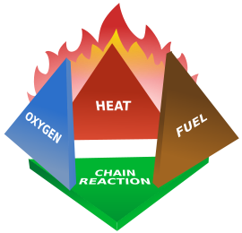
🔥 Fire! How Does It Work? 🔥
Heat + O₂ + Fuel
=
Rapid Self Sustaining
Exothermic Oxidizing
Chemical Reaction
AKA - FIRE
How Do We Put It Out?

Slide 66
In the Beginning, There Was ….
Water (or Dirt), Cut off O₂, Lower Temperature
🌊 + 🔥 = !(🔥) unless ...
🌊 + (⚡⚡⚡🔥) = ⚡⚡⚡☠⚡⚡⚡
🌊 + (🛢🔥) = 🔥🔥🔥☠🔥🔥🔥
🌊 + (🤘🔥) = 💥💥💥☠💥💥💥
We don’t like putting Water or Dirt on our computers.
What can we use instead?
Notes:
I couldn’t find a dumpster fire emoji nor a tirefire emoji :(

Slide 67
What about my Fire Extinguisher at home?
ABC Dry Chemical Fire Extinguisher = Also Bad
NH₄H₂PO₄ - Monoammonium Phosphate - main agent
Coats fuel (computer parts), barrier to Oxygen
Also somewhat corrosive. Baking Soda isn’t really much better
Won’t conduct electricity, so safe(r) for humans to use on live gear.
But still bad for computers.

Slide 68
Just Get Rid of the Oxygen?
Flood the facility with CO₂ / N₂ / Inert Gas / Hard Vacuum
Puts out fire, doesn’t harm gear … but …
O₂ level req’d to sustain life vs O₂ level that puts out fire
This can kill (and has killed) people
But such systems have been common off and on …
They are effective, cheap, and reliable …
But deaths are bad ☹☹☹☹

Slide 69
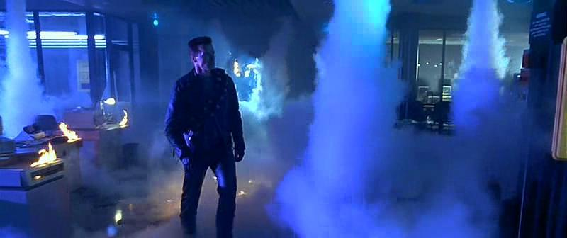
Ooooh, “Halon”

Slide 70
HALON!!!
Very Broad Class of Chemicals, dates back to 1839 (CCl₄)
Some Refrigerants, Some Fire Suppressants, Some both
Halon 1301 and Halon 1211 most typical
Montreal Protocol 1987 - Ozone Depletion Potential
Equipment-safe, effective, $$ vs H₂O/Inert Gas Flooding
Halon 1301/1211 - Mostly human-safe @ useful levels
No new Halon installs in the US anymore
Notes:
ODP - Ozone Depletion Potential
Provided for implementation of earlier 1985 Vienna Convention
Different from Int’l Commercial Air Travel related “Montreal Convention” of 1999.

Slide 71
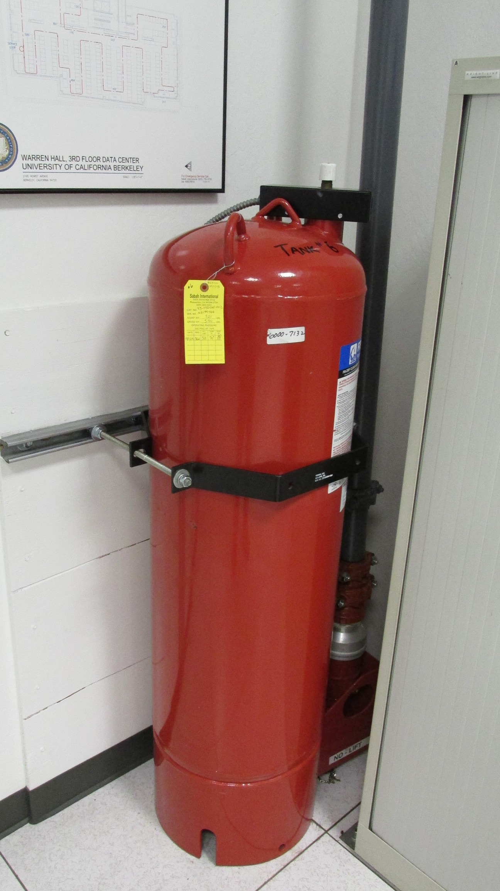
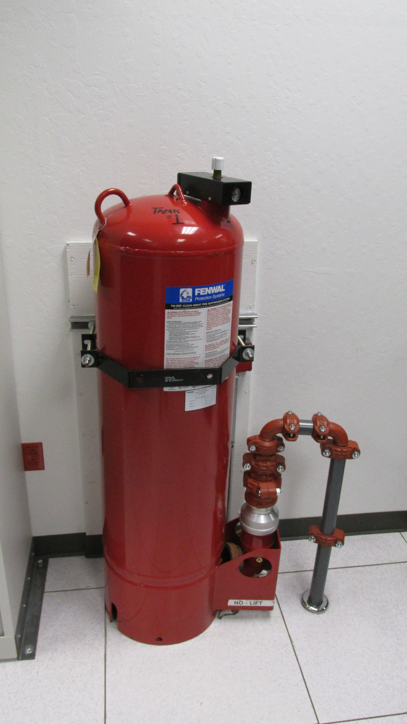
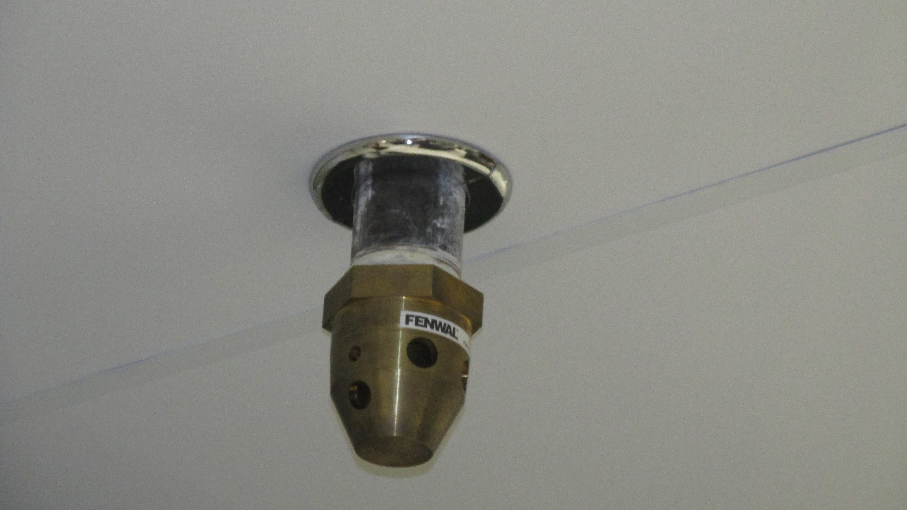
So, a nozzle and two FM-200 tanks walk into a bar ...

Slide 72
Halon is Dead, Long Live Halon Replacements
FM-200, Fluoroform - Ozone OK, high Global Warming
NOVEC, Halotron - Ozone OK, low Global Warming
Levels for effective fire suppression, little effect on humans.
FM-200 is also known as heptafluoropropane, a typical propellant for asthma inhalers.
Higher levels affect CNS. Very heavy inhalation … ☠

Slide 73
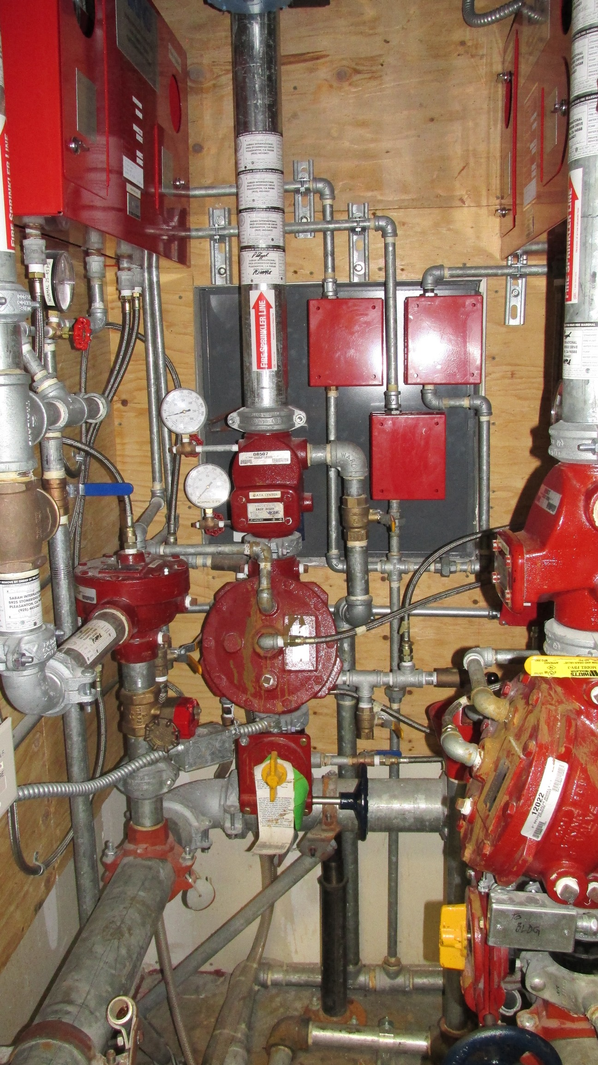
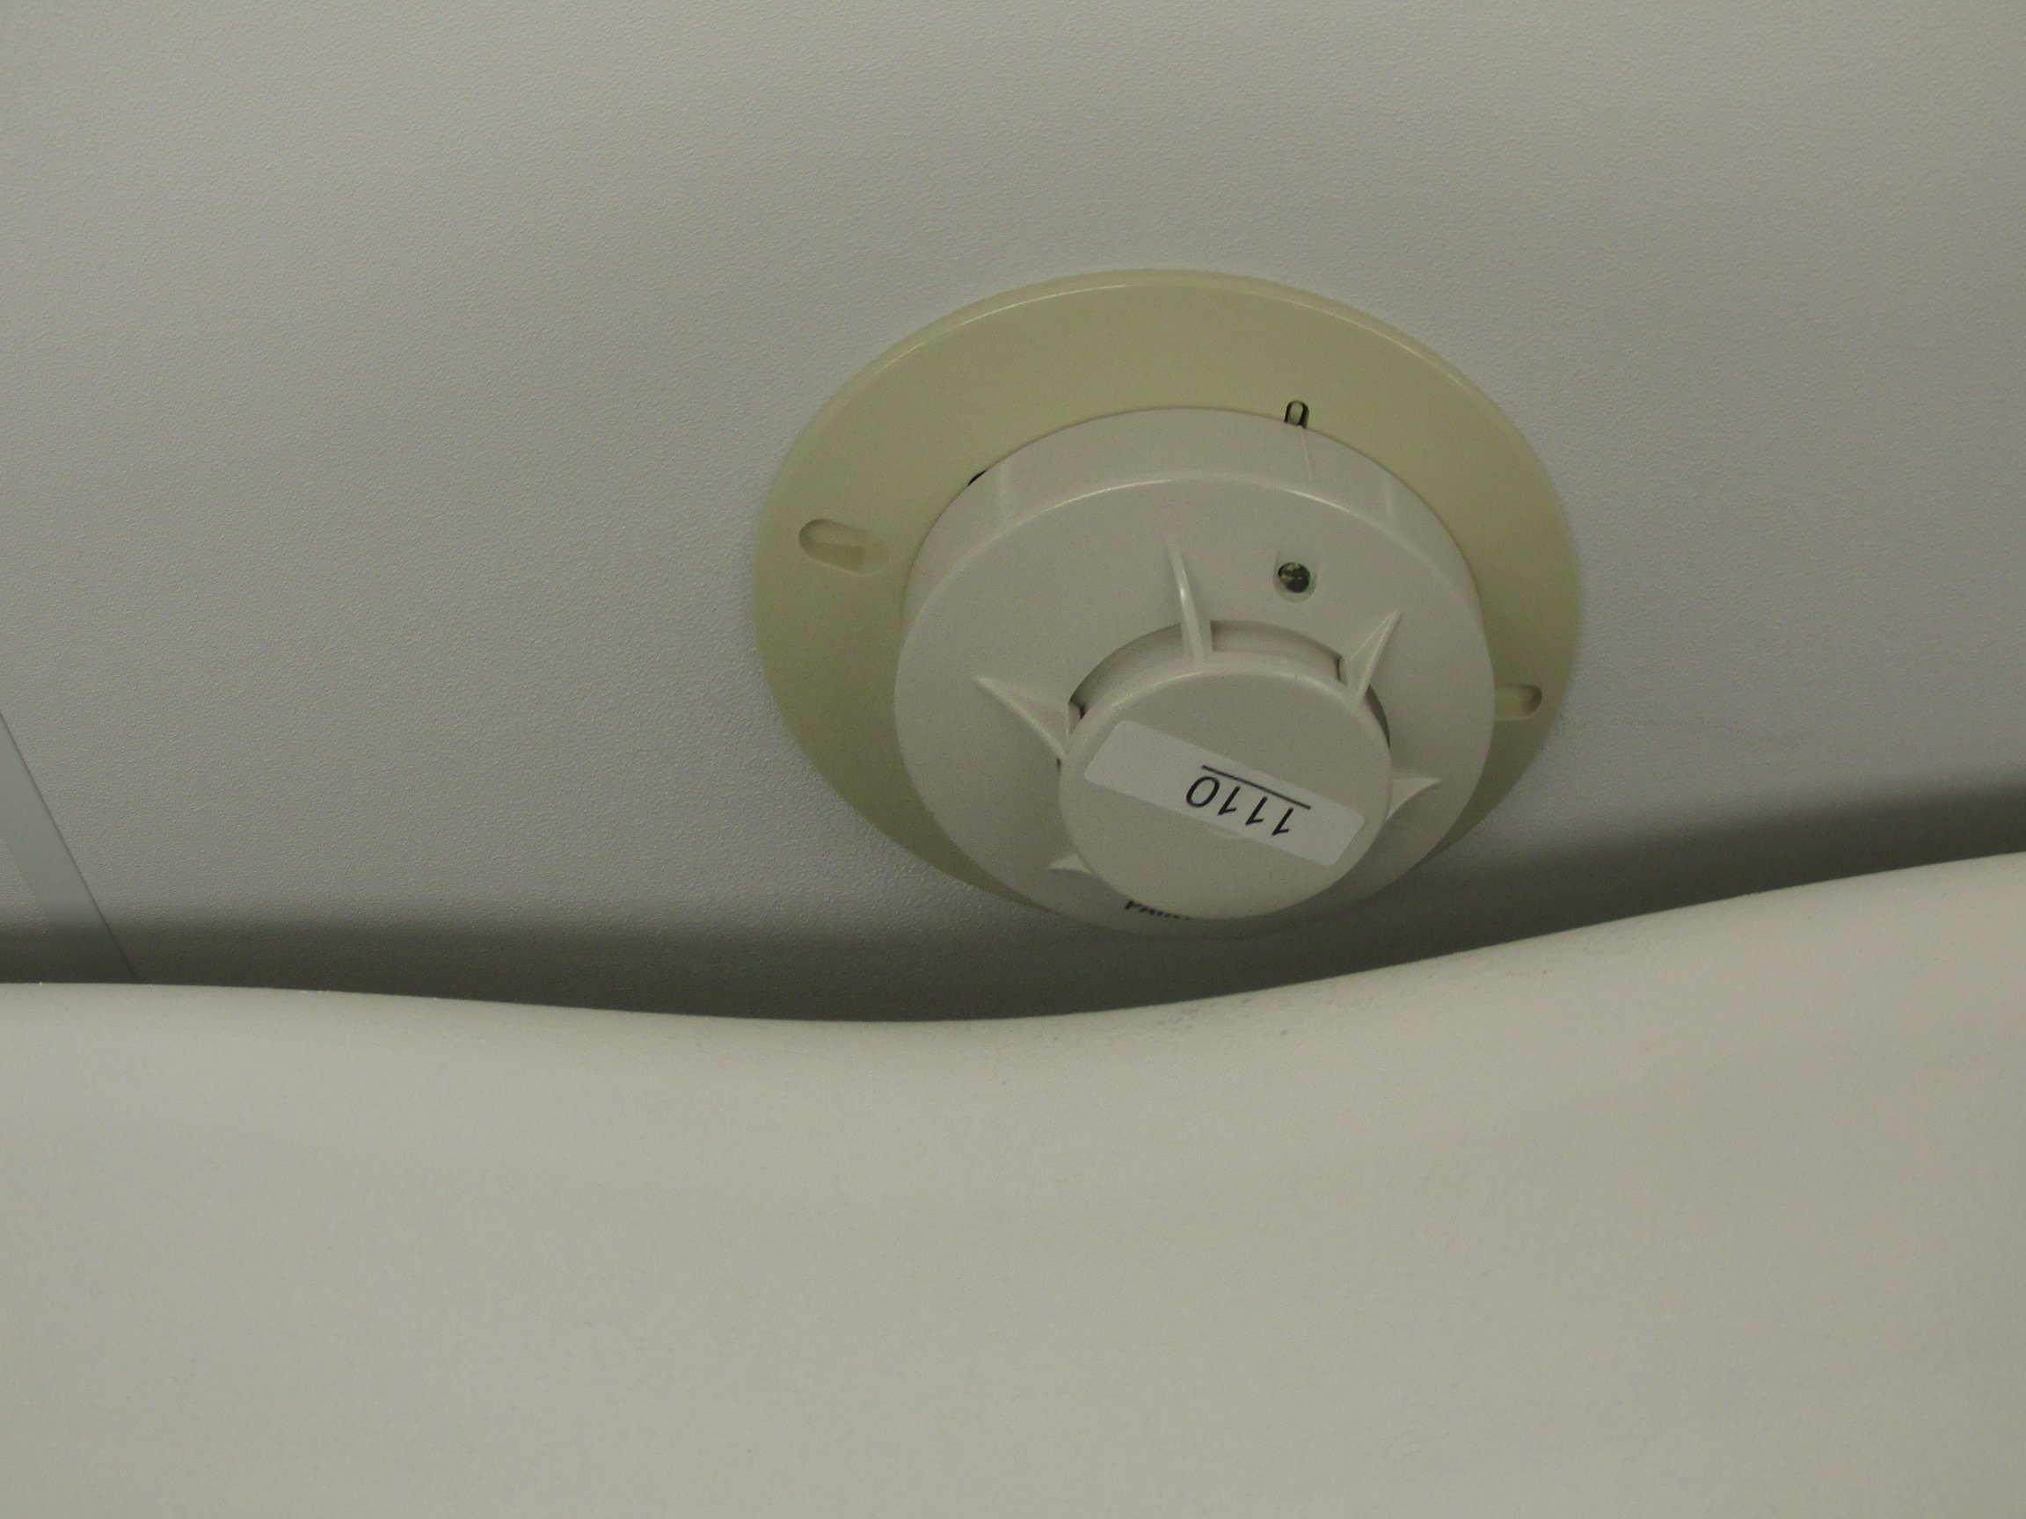
Your Fire Detection and Sprinkler System is ...
A
Series
Of
Tubes
Like
The
Internet

Slide 74
Fire Detection, Sprinkler Systems
Typical Passive Smoke Detection is relatively slow
VESDA - Very Early-warning Aspirating Smoke Detection
Much faster at detecting smoke, at loss of location-accuracy
Allows for staff intervention before problem escalates
However, sometimes it’s so early, nobody finds anything ☹
This can lead to belief system prone to “false alarms” ☹
Double Interlocked Pre-Action Sprinkler System
Requires smoke/heat sensor activation
Requires individual sprinkler head activation
Then Water can flow to activated sprinklers

