Slide 1
NetReg with Devices
Micronet 10/21/2015
Saskia Etling, saetling@security.berkeley.edu
Information Security and Policy

Slide 2
New IPAM
Network group changing IP Address Management System to Infoblox
DNS/ DHCP freeze starting EOB today
New DNS / DHCP system up 10/28
New DHCP registration portal in NetReg

Slide 3
Security Contact Role Types
Department (DCR) - has an orgnode
Group (GCR) - has a parent DCR
Service Provider (SP CR) - Can register IP addresses, MACs, etc. for its client security contacts
Individual (ICR) – One and only one Calnet UID member

Slide 4
Old DHCP registration portal
https://net-sec2.berkeley.edu/cgi-bin/dhcp_registration/dhcp_mac_registration.pl

Slide 5
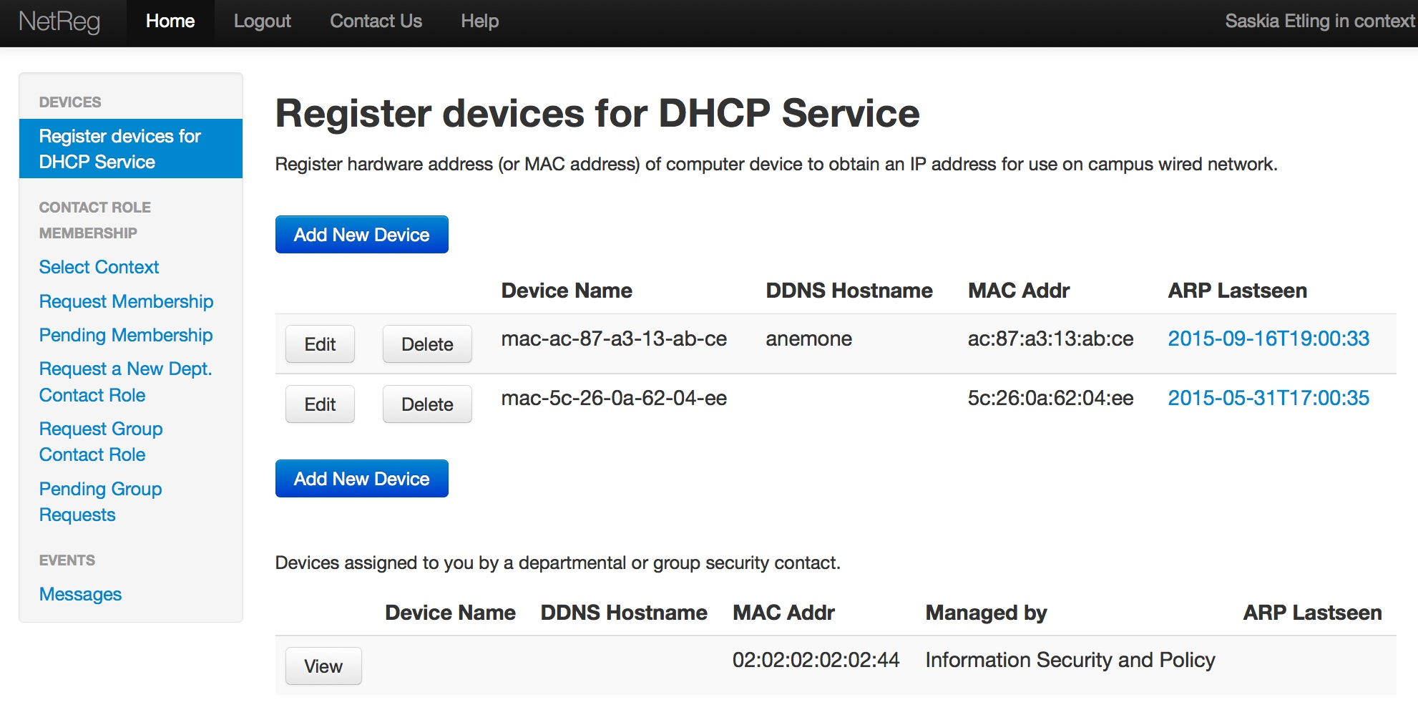
New DHCP registration portal
https://netreg.berkeley.edu/

Slide 6
NetReg Device registration
Allows departments AND individuals to register devices for DHCP service
Wired network service
Device = Ethernet MAC address
Departmental registration appropriate for university-owned devices
Correctly route security notices

Slide 7
New features for DCRs/GCRs
Bulk import MACs
Edit device names
Associate devices with end users’ CalNet IDs
Add notes
Edit DDNS
“Fixed” DHCP
Notes:
Sell it!

Slide 8
DDNS
DDNS – Dynamic Domain Name Service
“dyn.berkeley.edu” subdomain
Self- register DDNS hostnames
Caveat: Hostnames will be sent to hostmaster for review, anything inappropriate and she will contact the user and ask them to change it.

Slide 9
Fixed DHCP
Fixed DHCP always assigns a MAC the same IP on its primary subnet
The MAC will get a dynamic IP on any other subnet
Self-registered Fixed DHCP uses generated DNS
E.g., fixed-169-229-nnn-nnn.subdomain.berkeley.edu
Caveat: Limited to subdomains and subnets (with free IPs) registered to your security contact (or parent security contact, if any)

Slide 10
Not (yet) available
Other DHCP changes requires email to hostmaster.
Fixed registration using an existing hostname/IP address
Change from generated DNS for fixed registrations
Fixed registration by an individual

Slide 11
Conversion
MAC addresses are currently registered to individual CalNet UIDs
Will be converted to Individual contact roles (ICRs)
Existing registrations associated with expired or invalid CalNet UIDs will be converted to a special security contact role.
Individuals cannot claim subnets so they cannot register NEW fixed DHCP without an email to hostmaster.
Existing fixed DHCP registrations will be converted.

Slide 12
Transferring Devices
Any transfer of existing registrations, (for example, from Individuals to a Department or Group security contact), are currently handled by emailing netreg@security.berkeley.edu with the request.
In the future, some transfers will be self-service
Individuals transferring to any security contact of which they are a member, without creating a request
Or to any Group/Department via a request that must be approved
Others?

Slide 13
Routing Security Notices
Security notices for DHCP devices will be routed to the security contact that registered the device and the security contact that claims the IP address it used.
Also to a security contact’s Service Provider, if any.
Also to a security contact’s Parent, if any.
Security notices for WiFi will continue to be routed to the owner of the UID logged in at the time.

Slide 14
Demo Time!

Slide 15
Thanks
Questions, comments to netreg@security.berkeley.edu

