Slide 1
IST’s Cloud or Virtual Private Server Offering A history, challenges and where we are today
Blaine Isbelle
Jonathon Taylor
Notes:
Give a little background on who we are, how long we’ve been doing this

Slide 2
Agenda
History
Challenges
Current environment
Security
What’s next?

Slide 3
History
Why Virtualize
No hardware refresh downtime
Hardware failover
Flexibility
Lower costs
Better utilization of hardware (green technology)
Notes:
Emphasize shelf-life of servers
• hardware does die
• don’t have to pay for peak up-front, but can add additional hardware as needed for peak periods and only pay for that
• turn hardware upgrades around within 4 business hours
• VM typically 80% more efficient than hardware equivalent

Slide 4
History
Virtualizing the hardware layer
Notes:
VMware GSX 2002-2003
9 years ago
Active directory Training
Some minor development servers

Slide 5
History
Shared Storage
Notes:
ESX 2.5
Move to the SAN gave us the ability to move VMs to different hosts to balance load
Migration of development environments to VMs (P2Vs, new builds)
----- Meeting Notes (12/12/11 11:09) -----
JT - Click Twice

Slide 6
History
Clustered Hosts
Notes:
- Clustering gave us DRS, live migrations (VMotion), HA
- Inventory expansion in the form of more storage and more VMs
----- Meeting Notes (12/12/11 11:09) -----
JT - Click 1, 2, 3 times
When talkig about more hosts start to click again

Slide 7
History
SCSI Locking!!
Notes:
More hosts = more VMs = more storage = more hosts = more VMs = Locking issues

Slide 8
History
Smaller Clusters
Notes:
Creation of Smaller clusters & isolated storage to help combat locking issues
We still had the ability to move Guests between clusters
----- Meeting Notes (12/12/11 11:09) -----
JT - Click again

Slide 9
Current Environment
Environment today
2 Datacenters
5 Dell m1000e Blades Chassis (More on Order)
80 M610 12 core blades with 96GB of ram
50+ ESXi hosts
12 Clusters (5 multi-tenant, 7 dedicated)
~1000 virtual private servers
60% Windows
40% *nix
140+TB fiber connected SAN storage
Notes:
Including a Dedicated Production Oracle cluster
Four tiers of storage

Slide 10
Challenges
Keeping up with high adoption rate
Securing the environment

Slide 11
Challenges
Notes:
We are adding more servers per month
Comes with increased load on our systems administrators
We are now adding more than 1 vm per day on average
Need to do more with the same number of resources
WE also want to continuously improve our processes
Give more control to our customers
And balance this all with increased pressure to lower costs
We are aggressively pursing automation and self-service for this

Slide 12
Automation
Current Process
Self-service front-end
Estimator – http://estimator.berkeley.edu
Price server and support options
Notes:
Today the self-service portion of our service takes the form of the Estimator web tool
Developed in-house by Forrest Smalley who now works on the database team
Allows customers to price server configurations and support options and then place an order

Slide 13
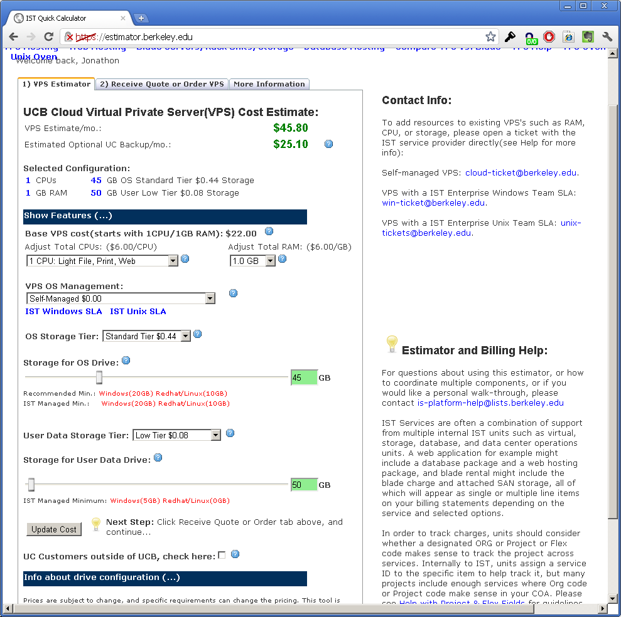
Automation
Notes:
Show various fields

Slide 14
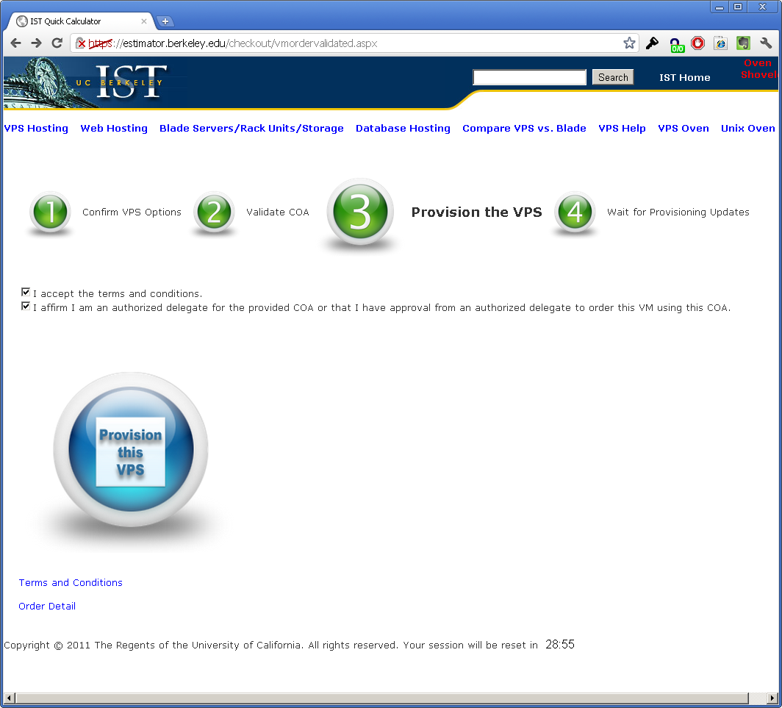
Automation
Notes:
Encourage people to go to the side and play around with the settings and prices

Slide 15
Automation
Current Process
Scripted back-end
Intelligent cluster and storage placement
VPS configuration
Inherent advantages
Quick turn-around
Notes:
Automation
Implemented as back-end scripts that are triggered from the orders placed through estimator
Environment analyzed based on requesting group, CPU, memory, and storage available on 5 multi-tenants clusters
OS Configuration (for non self-managed servers)
Advantages of automation
Quick and consistent provisioning
Auditing is built in
Limit the potential for human error
Turn-around
Generally within a business day for our part, no including DNS and specialized requests
What we have today works really well, be there is room for improvement given increased demand for the service

Slide 16
Automation
Next Steps
Introduce 3rd-party workflow
Faster turn-around
Business process and approvals
Proactive/reactive response
Notes:
Introduce 3rd-party workflow
Looking at a couple of products for this already
Focus on the business process
Turn requests for reports and changes to our processes around more quickly
Allows us to easily insert approvals at any step
Proactive/reactive response to the environment
Looking at ways to respond proactively to things like storage, so that we can order as part of our provisioning before we hit a critical level and have to put some requests on hold
We do always keep a buffer but from time to time we get large requests which introduce a delay
Reactively we are starting to work on automated resolutions to certain events with our servers and virtual environment

Slide 17
Challenges
Keeping up with high adoption rate
Securing the environment

Slide 18
Security and Configuration Management
Locking it down
Physical hardware
Hypervisor
All access done via bastion host
HyTrust Security Appliance
Root password vaulting
Principle of least privilege
Notes:
Mention the SAN

Slide 19
Use Cases
Dedicated Clusters
Logically isolated storage
Dedicated networks
Tuned for specific workloads
Granular access controls
Notes:
----- Meeting Notes (12/12/11 11:02) -----
Say what granular access is, for examle Haas has basically full control of their environment

Slide 20
Use Cases
Dedicated Cluster Customers
UC Merced
Offsite dedicated environment
University Health Services
CalNet
Haas
IST’s DBA Services
Oracle, MS SQL, MySQL, PostgreSQL

Slide 21
Use Cases
Virtual Private Server (VPS) Service
Multi-tenant Environment
Hearst Datacenter
San Diego Supercomputer Center (SDSC)
Notes:
Enterprise Windows team run in this environment

Slide 22
Use Cases
Virtual Private Server Service Customers
ASUC Grad Division
BFS HRMS
Boalt School of Law Office of Public Affairs
College of Letters and Science Office of the Registrar
Department of Chemistry SAIT
Disabled Students Program School of Public Health
EECS UC San Francisco
ETS University Relations
Notes:
Enterprise Windows team run in this environment
----- Meeting Notes (12/12/11 10:31) -----
Mention what some of these do, for example web servers, file server, db severs etc.

Slide 23
Where to next?
Upgrade to vSphere 5 Q1
Two-factor authentication Q2
HyTrust Security appliance
Auditing Q1
Configuration management Q1
Granular access control Q3
Data protection
Whole VPS instance backup Q4
More customer control

Slide 24
VPS Service Costs
VPS Base (1 vCPU, 1GB RAM) - $22/month
Each Additional 1GB RAM or 1 vCPU - $6/month
High Tier Storage $0.72/GB
Standard Tier Storage $0.36/GB
Economy Tier Storage $0.12/GB
Low Tier Storage $0.06/GB
Windows and Linux OS support and backups are options
No bandwidth restrictions or metering
Notes:
----- Meeting Notes (12/12/11 10:31) -----
Maybe gloss over this a little bit and go more into detail on the Dell comparison

Slide 25
ESX Service Costs
Dedicated ESX host (minimum of 2 per cluster) $629/host/month including licensing
Dell M610s
12 “physical” cores
96GB RAM
High Tier Storage $0.60/GB
Standard Tier Storage $0.30/GB
Economy Tier Storage $0.10/GB
Low Tier Storage $0.05/GB

Slide 26
VPS Cost Comparison
IST
VPS Base (1 vCPU, 1GB RAM) - $22/month
Each Additional 1GB RAM or 1 vCPU - $6/month
High Tier Storage $0.72/GB
Standard Tier Storage $0.36/GB
Economy Tier Storage $0.12/GB
Low Tier Storage $0.06/GB
No Bandwidth Charges
No Setup Fee
Dell
VPS Base (1 vCPU, 1GB RAM) - $46/month
Each Additional 1GB RAM or 1 vCPU - $23/month
Standard Tier Storage $0.50/GB
Economy Tier Storage $0.15/GB
Bandwidth $0.20 per GB
Account Setup Fee $2500
Notes:
----- Meeting Notes (12/12/11 10:31) -----
Move bandwidth down

Slide 27
Q/A
Questions?
Blaine Isbelle
bisbelle@berkeley.edu
Jonathon Taylor
jonathont@berkeley.edu
Estimator
http://estimator.berkeley.edu
Service Catalog
http://ist.berkeley.edu/services/is/virtual-servers

